Slide 1
Weekly report
Doan Manh Hung

Slide 2
Last Week
- Rectangular cross section – Shear force bending(2DOF)

Slide 3
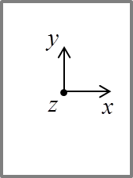












This week
Case1: 2dof
$${ψ_{s}}^{Vx}=\left\{\begin{matrix}\begin{matrix}0 \\ −1\end{matrix} \\ \begin{matrix}0 \\ 1\end{matrix}\end{matrix}\right\}$$
$${ψ_{s}}^{βy}=\left\{\begin{matrix}\begin{matrix}−b/2 \\ s\end{matrix} \\ \begin{matrix}b/2 \\ −s\end{matrix}\end{matrix}\right\}$$
F_{x}
F_{x}
$$Vx$$
$$βy$$
$$s_{2}$$
$$βy$$
$$z_{2}$$
$$s_{1}$$
$$z_{1}$$
$$s_{3}$$
$$z_{3}$$
$$z_{4}$$
$$s_{4}$$

Slide 4
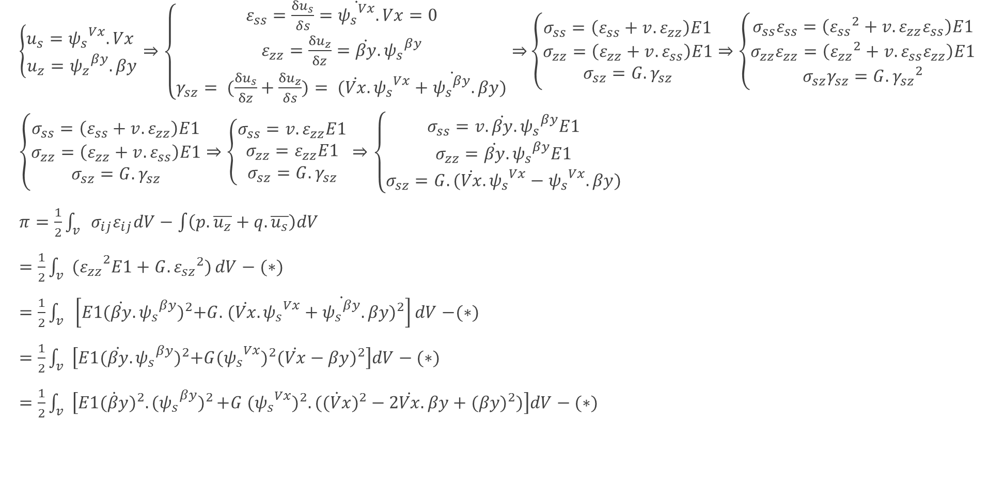
$\left\{\begin{matrix}u_{s}={ψ_{s}}^{Vx}.Vx \\ u_{z}={ψ_{z}}^{βy}.βy\end{matrix}\right.⇒\left\{\begin{matrix}ε_{ss}=\frac{{δu}_{s}}{δs}=\dot{{ψ_{s}}^{Vx}}.Vx=0 \\ ε_{zz}=\frac{{δu}_{z}}{δz}=\dot{βy}. {ψ_{s}}^{βy} \\ γ_{sz}= (\frac{{δu}_{s}}{δz}+\frac{{δu}_{z}}{δs})= (\dot{Vx}.{ψ_{s}}^{Vx}+\dot{{ψ_{s}}^{βy}}.βy)\end{matrix}⇒\right.\left\{\begin{matrix}σ_{ss}=\left(ε_{ss}+v.ε_{zz}\right)E1 \\ σ_{zz}=\left(ε_{zz}+v.ε_{ss}\right)E1 \\ σ_{sz}=G.γ_{sz}\end{matrix}\right.⇒\left\{\begin{matrix}σ_{ss}ε_{ss}=\left({ε_{ss}}^{2}+v.ε_{zz}ε_{ss}\right)E1 \\ σ_{zz}ε_{zz}=\left({ε_{zz}}^{2}+v.ε_{ss}ε_{zz}\right)E1 \\ σ_{sz}γ_{sz}=G. {γ_{sz}}^{2}\end{matrix}\right.$
$\left\{\begin{matrix}σ_{ss}=\left(ε_{ss}+v.ε_{zz}\right)E1 \\ σ_{zz}=\left(ε_{zz}+v.ε_{ss}\right)E1 \\ σ_{sz}=G.γ_{sz}\end{matrix}\right.⇒\left\{\begin{matrix}σ_{ss}=v.ε_{zz}E1 \\ σ_{zz}=ε_{zz}E1 \\ σ_{sz}=G.γ_{sz}\end{matrix}\right.⇒\left\{\begin{matrix}σ_{ss}=v.\dot{βy}. {ψ_{s}}^{βy}E1 \\ σ_{zz}=\dot{βy}. {ψ_{s}}^{βy}E1 \\ σ_{sz}=G.(\dot{Vx}.{ψ_{s}}^{Vx}−{ψ_{s}}^{Vx}.βy)\end{matrix}\right.$
$π=\frac{1}{2}\int_{v}{{σ_{ij}ε}_{ij}dV}−\int{\left(p.\overline{u_{z}}+q.\overline{u_{s}}\right)dV}$
$=\frac{1}{2}\int_{v}{{{(ε}_{zz}}^{2}E1+G. {ε_{sz}}^{2})}dV−(∗)$
$=\frac{1}{2}\int_{v}{\left[E1{(\dot{βy}. {ψ_{s}}^{βy})}^{2}+G. { (\dot{Vx}.{ψ_{s}}^{Vx}+\dot{{ψ_{s}}^{βy}}.βy)}^{2}\right]dV}$ $−(∗)$
$=\frac{1}{2}\int_{v}{\left[E1{(\dot{βy}. {ψ_{s}}^{βy})}^{2}+G{{(ψ_{s}}^{Vx})}^{2}{(\dot{Vx}−βy)}^{2}\right]dV}−(∗)$
$=\frac{1}{2}\int_{v}{\left[E1{\dot{(βy})}^{2}{.{(ψ_{s}}^{βy})}^{2}+G {{({ψ_{s}}^{Vx})}^{2}.({\dot{(Vx})}^{2}−2\dot{Vx}.βy+(βy)}^{2})\right]dV}−(∗)$

Slide 5
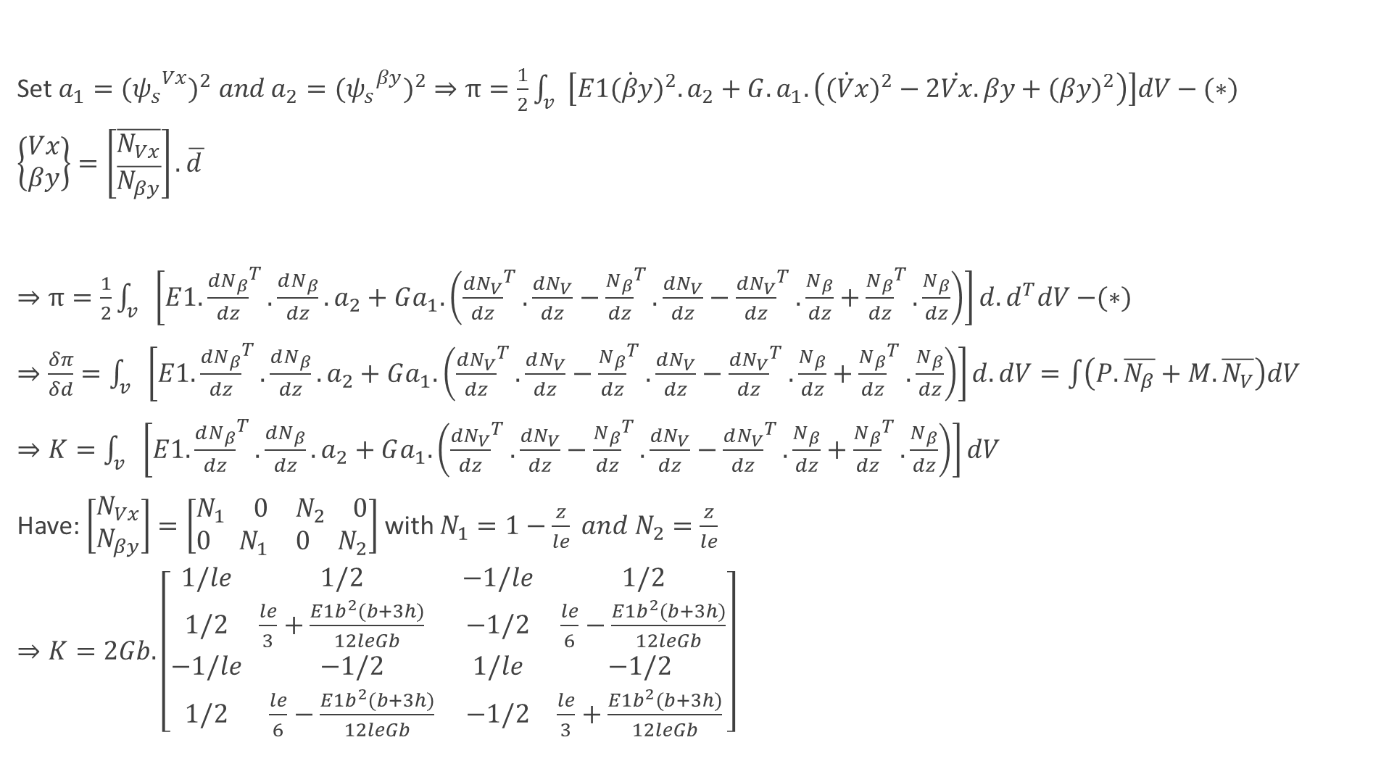
Set $a_{1}={({ψ_{s}}^{Vx})}^{2} and a_{2}={{(ψ_{s}}^{βy})}^{2}⇒π=\frac{1}{2}\int_{v}{\left[E1{\dot{(βy})}^{2}.a_{2}+G.a_{1}.\left({\dot{(Vx})}^{2}−2\dot{Vx}.βy+{(βy)}^{2}\right)\right]dV}−(∗)$
$\left\{\begin{matrix}Vx \\ βy\end{matrix}\right\}=\left[\begin{matrix}\overline{N_{Vx}} \\ \overline{N_{βy}}\end{matrix}\right].\overline{d }$
$⇒π=\frac{1}{2}\int_{v}{\left[E1. {\frac{dN_{β}}{dz}}^{T}.\frac{dN_{β}}{dz}. a_{2}+Ga_{1}. \left({\frac{dN_{V}}{dz}}^{T}.\frac{dN_{V}}{dz}−{\frac{N_{β}}{dz}}^{T}.\frac{dN_{V}}{dz}−{\frac{dN_{V}}{dz}}^{T}.\frac{N_{β}}{dz}+{\frac{N_{β}}{dz}}^{T}.\frac{N_{β}}{dz}\right)\right]d.d^{T}dV}$ $−(∗)$
$⇒\frac{δπ}{δd}=\int_{v}{\left[E1. {\frac{dN_{β}}{dz}}^{T}.\frac{dN_{β}}{dz}. a_{2}+Ga_{1}. \left({\frac{dN_{V}}{dz}}^{T}.\frac{dN_{V}}{dz}−{\frac{N_{β}}{dz}}^{T}.\frac{dN_{V}}{dz}−{\frac{dN_{V}}{dz}}^{T}.\frac{N_{β}}{dz}+{\frac{N_{β}}{dz}}^{T}.\frac{N_{β}}{dz}\right)\right]d.dV}=\int{\left(P.\overline{N_{β}}+M.\overline{N_{V}}\right)dV}$
$⇒K=\int_{v}{\left[E1. {\frac{dN_{β}}{dz}}^{T}.\frac{dN_{β}}{dz}. a_{2}+Ga_{1}. \left({\frac{dN_{V}}{dz}}^{T}.\frac{dN_{V}}{dz}−{\frac{N_{β}}{dz}}^{T}.\frac{dN_{V}}{dz}−{\frac{dN_{V}}{dz}}^{T}.\frac{N_{β}}{dz}+{\frac{N_{β}}{dz}}^{T}.\frac{N_{β}}{dz}\right)\right]dV}$
Have: $\left[\begin{matrix}N_{Vx} \\ N_{βy}\end{matrix}\right]=\left[\begin{matrix}\begin{matrix}\begin{matrix}N_{1} & 0\end{matrix} & \begin{matrix}N_{2} & 0\end{matrix}\end{matrix} \\ \begin{matrix}\begin{matrix}0 & N_{1}\end{matrix} & \begin{matrix}0 & N_{2}\end{matrix}\end{matrix}\end{matrix}\right]$ with $N_{1}=1−\frac{z}{le} and{ N}_{2}=\frac{z}{le}$
$⇒K=2Gb.\left[\begin{matrix}\begin{matrix}1/le & 1/2 \\ 1/2 & \frac{le}{3}+\frac{E1b^{2}(b+3h)}{12leGb}\end{matrix} & \begin{matrix}−1/le & 1/2 \\ −1/2 & \frac{le}{6}−\frac{E1b^{2}(b+3h)}{12leGb}\end{matrix} \\ \begin{matrix}−1/le & −1/2 \\ 1/2 & \frac{le}{6}−\frac{E1b^{2}(b+3h)}{12leGb}\end{matrix} & \begin{matrix}1/le & −1/2 \\ −1/2 & \frac{le}{3}+\frac{E1b^{2}(b+3h)}{12leGb}\end{matrix}\end{matrix}\right]$

Slide 6
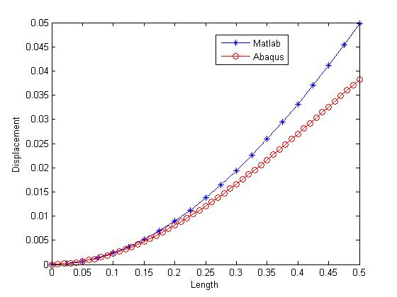
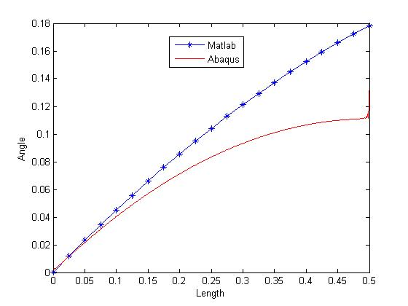
Result

Slide 7
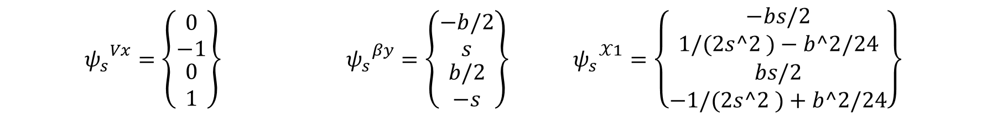



$${ψ_{s}}^{Vx}=\left\{\begin{matrix}\begin{matrix}0 \\ −1\end{matrix} \\ \begin{matrix}0 \\ 1\end{matrix}\end{matrix}\right\} {{ ψ}_{s}}^{βy}=\left\{\begin{matrix}\begin{matrix}−b/2 \\ s\end{matrix} \\ \begin{matrix}b/2 \\ −s\end{matrix}\end{matrix}\right\}{{ ψ}_{s}}^{𝒳1}=\left\{\begin{matrix}\begin{matrix}−bs/2 \\ 1/(2s^2 )−b^2/24\end{matrix} \\ \begin{matrix}bs/2 \\ −1/(2s^2 )+b^2/24\end{matrix}\end{matrix}\right\}$$
Case1: 3dof
$$Vx$$
$$βy$$
$$χ_{1}$$
$$s_{2}$$
$$βy$$
$$z_{2}$$
$$s_{1}$$
$$z_{1}$$
$$s_{3}$$
$$z_{3}$$
$$z_{4}$$
$$s_{4}$$

Slide 8
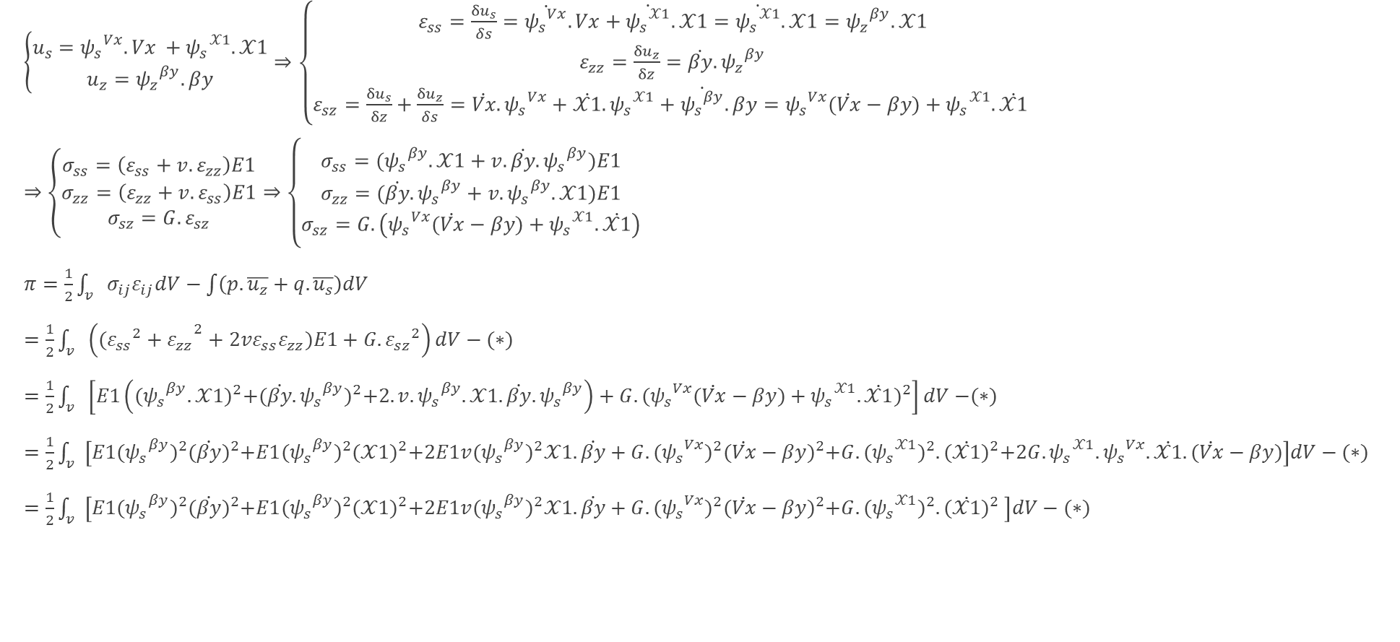
$\left\{\begin{matrix}u_{s}={ψ_{s}}^{Vx}.Vx +{ψ_{s}}^{𝒳1}.𝒳1 \\ u_{z}={ψ_{z}}^{βy}.βy\end{matrix}\right.⇒\left\{\begin{matrix}ε_{ss}=\frac{{δu}_{s}}{δs}=\dot{{ψ_{s}}^{Vx}}.Vx+\dot{{ψ_{s}}^{𝒳1}}.𝒳1=\dot{{ψ_{s}}^{𝒳1}}.𝒳1={ψ_{z}}^{βy}.𝒳1 \\ ε_{zz}=\frac{{δu}_{z}}{δz}=\dot{βy}. {ψ_{z}}^{βy} \\ ε_{sz}=\frac{{δu}_{s}}{δz}+\frac{{δu}_{z}}{δs}=\dot{Vx}.{ψ_{s}}^{Vx}+\dot{𝒳1}.{ψ_{s}}^{𝒳1}+\dot{{ψ_{s}}^{βy}}.βy={ψ_{s}}^{Vx}(\dot{Vx}−βy)+{ψ_{s}}^{𝒳1}.\dot{𝒳1} \end{matrix}\right.$
$⇒\left\{\begin{matrix}σ_{ss}=\left(ε_{ss}+v.ε_{zz}\right)E1 \\ σ_{zz}=\left(ε_{zz}+v.ε_{ss}\right)E1 \\ σ_{sz}=G.ε_{sz}\end{matrix}\right.⇒\left\{\begin{matrix}σ_{ss}=({ψ_{s}}^{βy}.𝒳1+v.\dot{βy}. {ψ_{s}}^{βy})E1 \\ σ_{zz}=(\dot{βy}. {ψ_{s}}^{βy}+v.{ψ_{s}}^{βy}.𝒳1)E1 \\ σ_{sz}=G.\left({ψ_{s}}^{Vx}(\dot{Vx}−βy)+{ψ_{s}}^{𝒳1}.\dot{𝒳1}\right)\end{matrix}\right.$
$π=\frac{1}{2}\int_{v}{{σ_{ij}ε}_{ij}dV}−\int{\left(p.\overline{u_{z}}+q.\overline{u_{s}}\right)dV}$
$=\frac{1}{2}\int_{v}{\left(({{{ε_{ss}}^{2}+ε}_{zz}}^{2}+2vε_{ss}ε_{zz})E1+G. {ε_{sz}}^{2}\right)}dV−(∗)$
$=\frac{1}{2}\int_{v}{\left[E1\left({({ψ_{s}}^{βy}.𝒳1)}^{2}+{(\dot{βy}. {ψ_{s}}^{βy})}^{2}+2.v.{ψ_{s}}^{βy}.𝒳1.\dot{βy}. {ψ_{s}}^{βy}\right)+G. {({ψ_{s}}^{Vx}(\dot{Vx}−βy)+{ψ_{s}}^{𝒳1}.\dot{𝒳1})}^{2}\right]dV}$ $−(∗)$
$=\frac{1}{2}\int_{v}{\left[E1{({ψ_{s}}^{βy})}^{2}{(\dot{βy})}^{2}+{E1({ψ_{s}}^{βy})}^{2}{(𝒳1)}^{2}+2E1v{({ψ_{s}}^{βy})}^{2}𝒳1.\dot{βy}+G. {{(ψ_{s}}^{Vx})}^{2}{(\dot{Vx}−βy)}^{2}+G.{({ψ_{s}}^{𝒳1})}^{2}.{(\dot{𝒳1})}^{2}+2G.{ψ_{s}}^{𝒳1}.{ψ_{s}}^{Vx}.\dot{𝒳1}.(\dot{Vx}−βy)\right]dV}−(∗)$
$=\frac{1}{2}\int_{v}{\left[E1{({ψ_{s}}^{βy})}^{2}{(\dot{βy})}^{2}+{E1({ψ_{s}}^{βy})}^{2}{(𝒳1)}^{2}+2E1v{({ψ_{s}}^{βy})}^{2}𝒳1.\dot{βy}+G. {{(ψ_{s}}^{Vx})}^{2}{(\dot{Vx}−βy)}^{2}+G.{({ψ_{s}}^{𝒳1})}^{2}.{(\dot{𝒳1})}^{2} \right]dV}−(∗)$

Slide 9
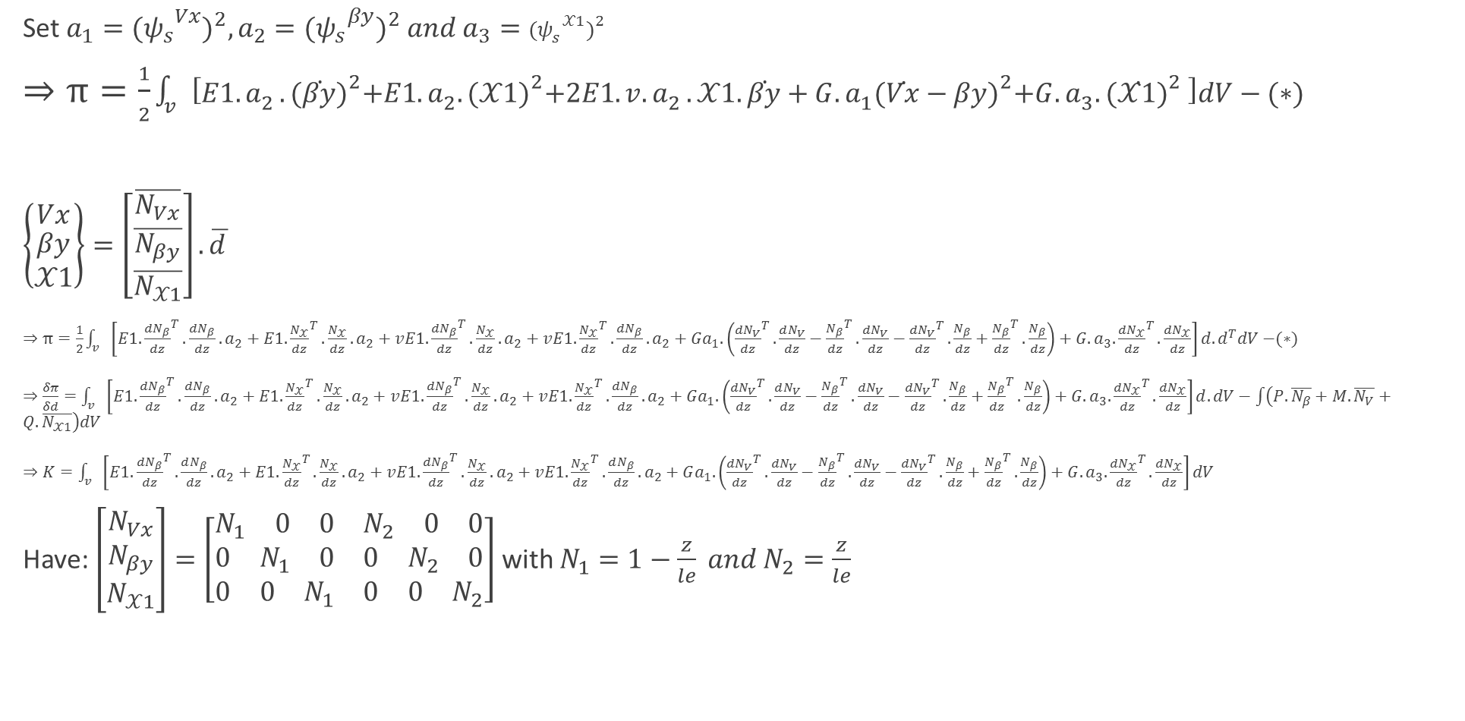
Set $a_{1}={({ψ_{s}}^{Vx})}^{2},a_{2}={{(ψ_{s}}^{βy})}^{2} and a_{3}={({ψ_{s}}^{𝒳1})}^{2}$
$⇒π=\frac{1}{2}\int_{v}{\left[E1{.a}_{2}.{(\dot{βy})}^{2}+E1.a_{2}.{(𝒳1)}^{2}+2E1.v{.a}_{2}.𝒳1.\dot{βy}+G.a_{1}{(\dot{Vx}−βy)}^{2}+G.a_{3}.{(\dot{𝒳1})}^{2} \right]dV}−(∗)$
$\left\{\begin{matrix}Vx \\ \begin{aligned}βy \\ 𝒳1\end{aligned}\end{matrix}\right\}=\left[\begin{matrix}\overline{N_{Vx}} \\ \overline{\begin{aligned}N_{βy} \\ \overline{N_{𝒳1}}\end{aligned}}\end{matrix}\right].\overline{d }$
$⇒π=\frac{1}{2}\int_{v}{\left[E1. {\frac{dN_{β}}{dz}}^{T}.\frac{dN_{β}}{dz}. a_{2}+E1. {\frac{N_{𝒳}}{dz}}^{T}.\frac{N_{𝒳}}{dz}. a_{2}+vE1. {\frac{dN_{β}}{dz}}^{T}.\frac{N_{𝒳}}{dz}. a_{2}+vE1. {\frac{N_{𝒳}}{dz}}^{T}.\frac{dN_{β}}{dz}. a_{2}+Ga_{1}. \left({\frac{dN_{V}}{dz}}^{T}.\frac{dN_{V}}{dz}−{\frac{N_{β}}{dz}}^{T}.\frac{dN_{V}}{dz}−{\frac{dN_{V}}{dz}}^{T}.\frac{N_{β}}{dz}+{\frac{N_{β}}{dz}}^{T}.\frac{N_{β}}{dz}\right)+G.a_{3}.{\frac{{dN}_{𝒳}}{dz}}^{T}.\frac{dN_{𝒳}}{dz}\right]d.d^{T}dV}$ $−(∗)$
$⇒\frac{δπ}{δd}=\int_{v}{\left[E1. {\frac{dN_{β}}{dz}}^{T}.\frac{dN_{β}}{dz}. a_{2}+E1. {\frac{N_{𝒳}}{dz}}^{T}.\frac{N_{𝒳}}{dz}. a_{2}+vE1. {\frac{dN_{β}}{dz}}^{T}.\frac{N_{𝒳}}{dz}. a_{2}+vE1. {\frac{N_{𝒳}}{dz}}^{T}.\frac{dN_{β}}{dz}. a_{2}+Ga_{1}. \left({\frac{dN_{V}}{dz}}^{T}.\frac{dN_{V}}{dz}−{\frac{N_{β}}{dz}}^{T}.\frac{dN_{V}}{dz}−{\frac{dN_{V}}{dz}}^{T}.\frac{N_{β}}{dz}+{\frac{N_{β}}{dz}}^{T}.\frac{N_{β}}{dz}\right)+G.a_{3}.{\frac{{dN}_{𝒳}}{dz}}^{T}.\frac{dN_{𝒳}}{dz}\right]d. dV}−\int{\left(P.\overline{N_{β}}+M.\overline{N_{V}}+Q.\overline{N_{𝒳1}}\right)dV}$
$⇒K=\int_{v}{\left[E1. {\frac{dN_{β}}{dz}}^{T}.\frac{dN_{β}}{dz}. a_{2}+E1. {\frac{N_{𝒳}}{dz}}^{T}.\frac{N_{𝒳}}{dz}. a_{2}+vE1. {\frac{dN_{β}}{dz}}^{T}.\frac{N_{𝒳}}{dz}. a_{2}+vE1. {\frac{N_{𝒳}}{dz}}^{T}.\frac{dN_{β}}{dz}. a_{2}+Ga_{1}. \left({\frac{dN_{V}}{dz}}^{T}.\frac{dN_{V}}{dz}−{\frac{N_{β}}{dz}}^{T}.\frac{dN_{V}}{dz}−{\frac{dN_{V}}{dz}}^{T}.\frac{N_{β}}{dz}+{\frac{N_{β}}{dz}}^{T}.\frac{N_{β}}{dz}\right)+G.a_{3}.{\frac{{dN}_{𝒳}}{dz}}^{T}.\frac{dN_{𝒳}}{dz}\right]dV}$
Have: $\left[\begin{matrix}N_{Vx} \\ \begin{aligned}N_{βy} \\ N_{𝒳1}\end{aligned}\end{matrix}\right]=\left[\begin{matrix}\begin{matrix}N_{1} & 0 & 0\end{matrix} & \begin{matrix}N_{2} & 0 & 0\end{matrix} \\ \begin{matrix}0 & N_{1} & 0\end{matrix} & \begin{matrix}0 & N_{2} & 0\end{matrix} \\ \begin{matrix}0 & 0 & N_{1}\end{matrix} & \begin{matrix}0 & 0 & N_{2}\end{matrix}\end{matrix}\right]$ with $N_{1}=1−\frac{z}{le} and{ N}_{2}=\frac{z}{le}$

Slide 10
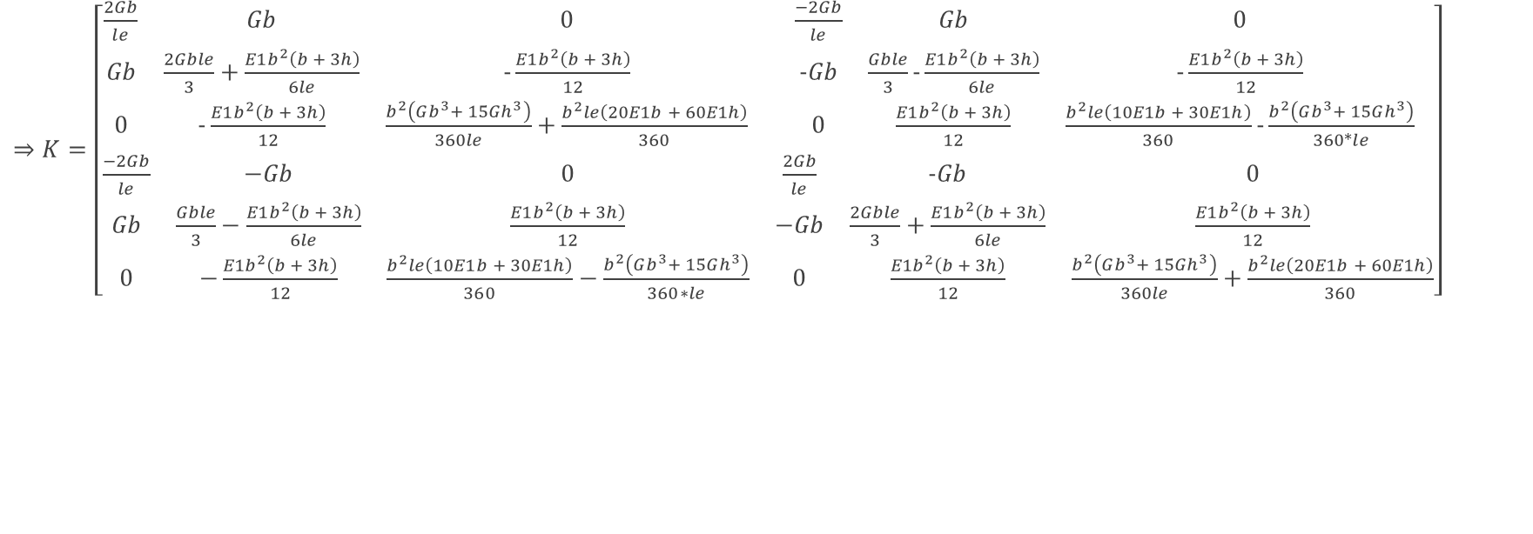
$⇒K=\left[\begin{matrix}\begin{matrix}\frac{2Gb}{le} & Gb & 0 \\ Gb & \frac{2Gble}{3}+\frac{E1b^{2}\left(b + 3h\right)}{6le} & −\frac{E1b^{2}\left(b + 3h\right)}{12} \\ 0 & −\frac{E1b^{2}\left(b + 3h\right)}{12} & \frac{b^{2}\left(Gb^{3}+ 15Gh^{3}\right)}{360le}+\frac{b^{2}le\left(20E1b + 60E1h\right)}{360}\end{matrix} & \begin{matrix}\frac{−2Gb}{le} & Gb & 0 \\ −Gb & \frac{Gble}{3}−\frac{E1b^{2}\left(b + 3h\right)}{6le} & −\frac{E1b^{2}\left(b + 3h\right)}{12} \\ 0 & \frac{E1b^{2}\left(b + 3h\right)}{12} & \frac{b^{2}le\left(10E1b + 30E1h\right)}{360}−\frac{b^{2}\left(Gb^{3}+ 15Gh^{3}\right)}{360∗le}\end{matrix} \\ \begin{matrix}\frac{−2Gb}{le} & −Gb & 0 \\ Gb & \frac{Gble}{3}−\frac{E1b^{2}\left(b + 3h\right)}{6le} & \frac{E1b^{2}\left(b + 3h\right)}{12} \\ 0 & −\frac{E1b^{2}\left(b + 3h\right)}{12} & \frac{b^{2}le\left(10E1b + 30E1h\right)}{360}−\frac{b^{2}\left(Gb^{3}+ 15Gh^{3}\right)}{360∗le}\end{matrix} & \begin{matrix}\frac{2Gb}{le} & −Gb & 0 \\ −Gb & \frac{2Gble}{3}+\frac{E1b^{2}\left(b + 3h\right)}{6le} & \frac{E1b^{2}\left(b + 3h\right)}{12} \\ 0 & \frac{E1b^{2}\left(b + 3h\right)}{12} & \frac{b^{2}\left(Gb^{3}+ 15Gh^{3}\right)}{360le}+\frac{b^{2}le\left(20E1b + 60E1h\right)}{360}\end{matrix}\end{matrix}\right]$

Slide 11
Next week
Calculate stress in previous case and do some other case

